Slide 1

ED 6002: Optimization Methods in Engineering Design (2024-25)
Parametric design optimization of an I-section beam using Autodesk Inventor™
Assignment-1
Submitted to- Prof. G. Saravana Kumar
Dept of ED IIT Madras
Submitted by- Amit Pathak
MM21S024

Slide 2
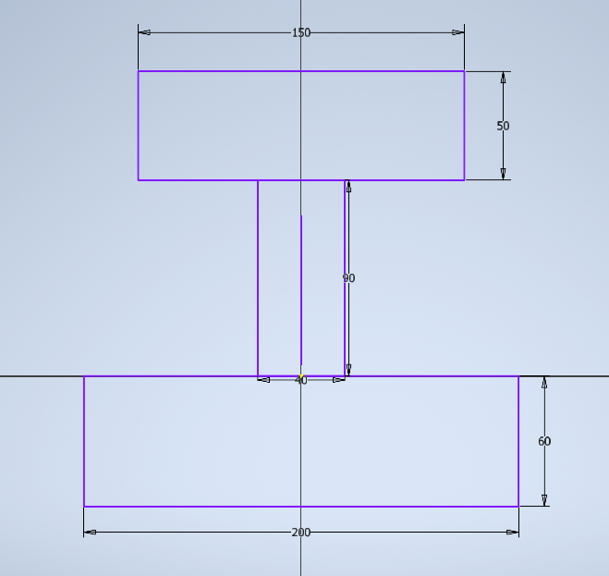
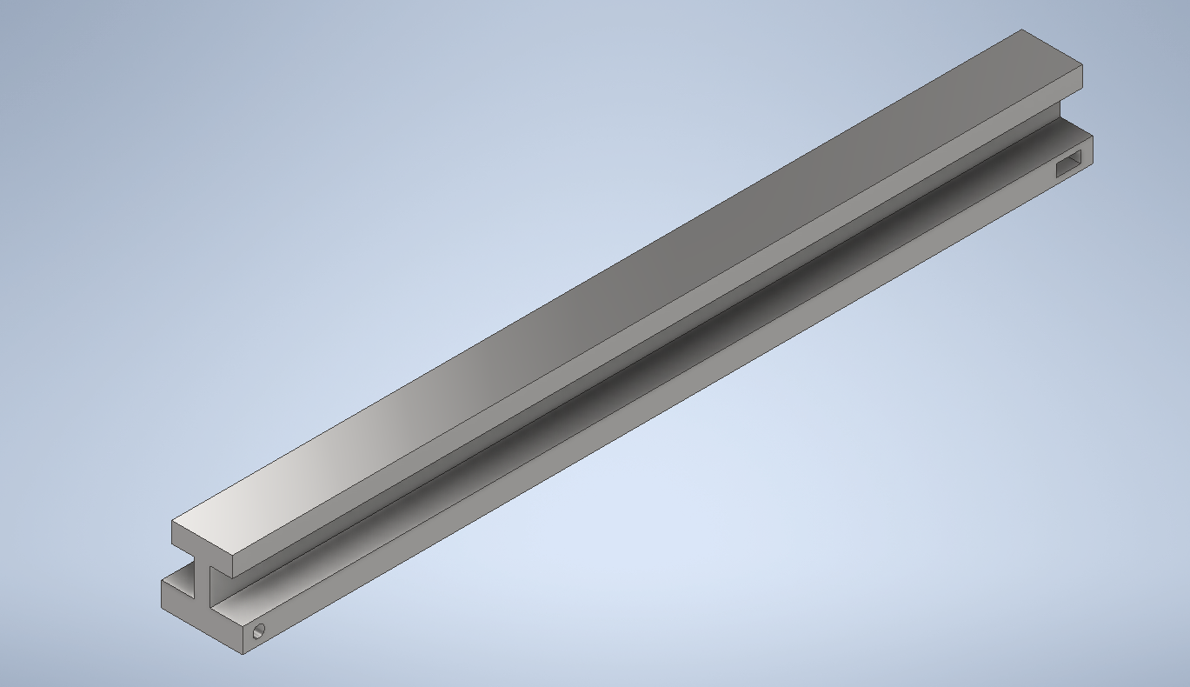
Design of I-section Beam
A beam was designed with the initial values of parameters
t1=50 mm, t2=40mm, t3=60mm, w1=150mm, w2=200mm,a= 90mm
Coincident and symmetric constraints were applied in the 2D sketch to make sure that the geometry changes proportionally in all the dimensions.
Internal hinges were provided to design for a worst-case scenario.
Fig. 2D sketch design
Fig. Beam design

Slide 3
Design of Experiment
A three-level DOE for all the six parameters has been designed with +/- 20% variation as bounds.
Design constraints were applied on
1. Max stress value < σyield / Factor of safety (140 MPa)
2. Maximum value of deflection < 1mm
An exhaustive set of simulations were carried out
Number of simulations= 3⁶ =729

Slide 4
Framework for report generation, data extraction, polynomial regression and optimization
Data extraction for all the configurations
t1,t2,t3,w1,w2, a, mass, deflection and stress in .csv format
Report Generation in Inventor
In .html format for various configurations
Sensitivity analysis
Optimal design in DOE
Single Objective multi-constraint optimization
Minimizing mass subject to constraints
Sensitivity analysis
Plotting coefficient for all parameters in the expression of Mass, Deflection and Stress
Polynomial regression and expression generation
Mass= f(t1,t2,t3,w1,w2,a)
Stress= f(t1,t2,t3,w1,w2,a)
Deflection= f(t1,t2,t3,w1,w2,a)
Optimized design for the beam

Slide 5
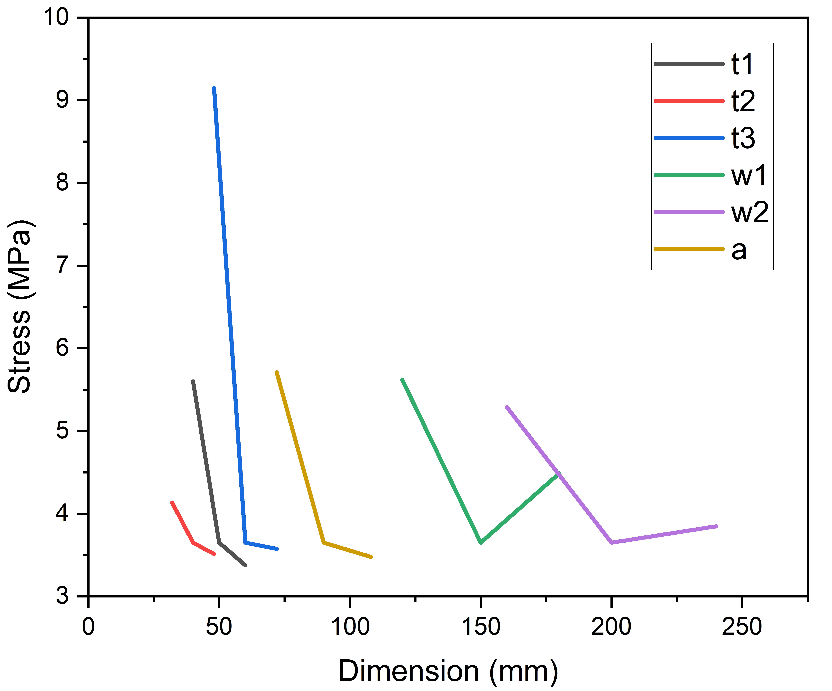
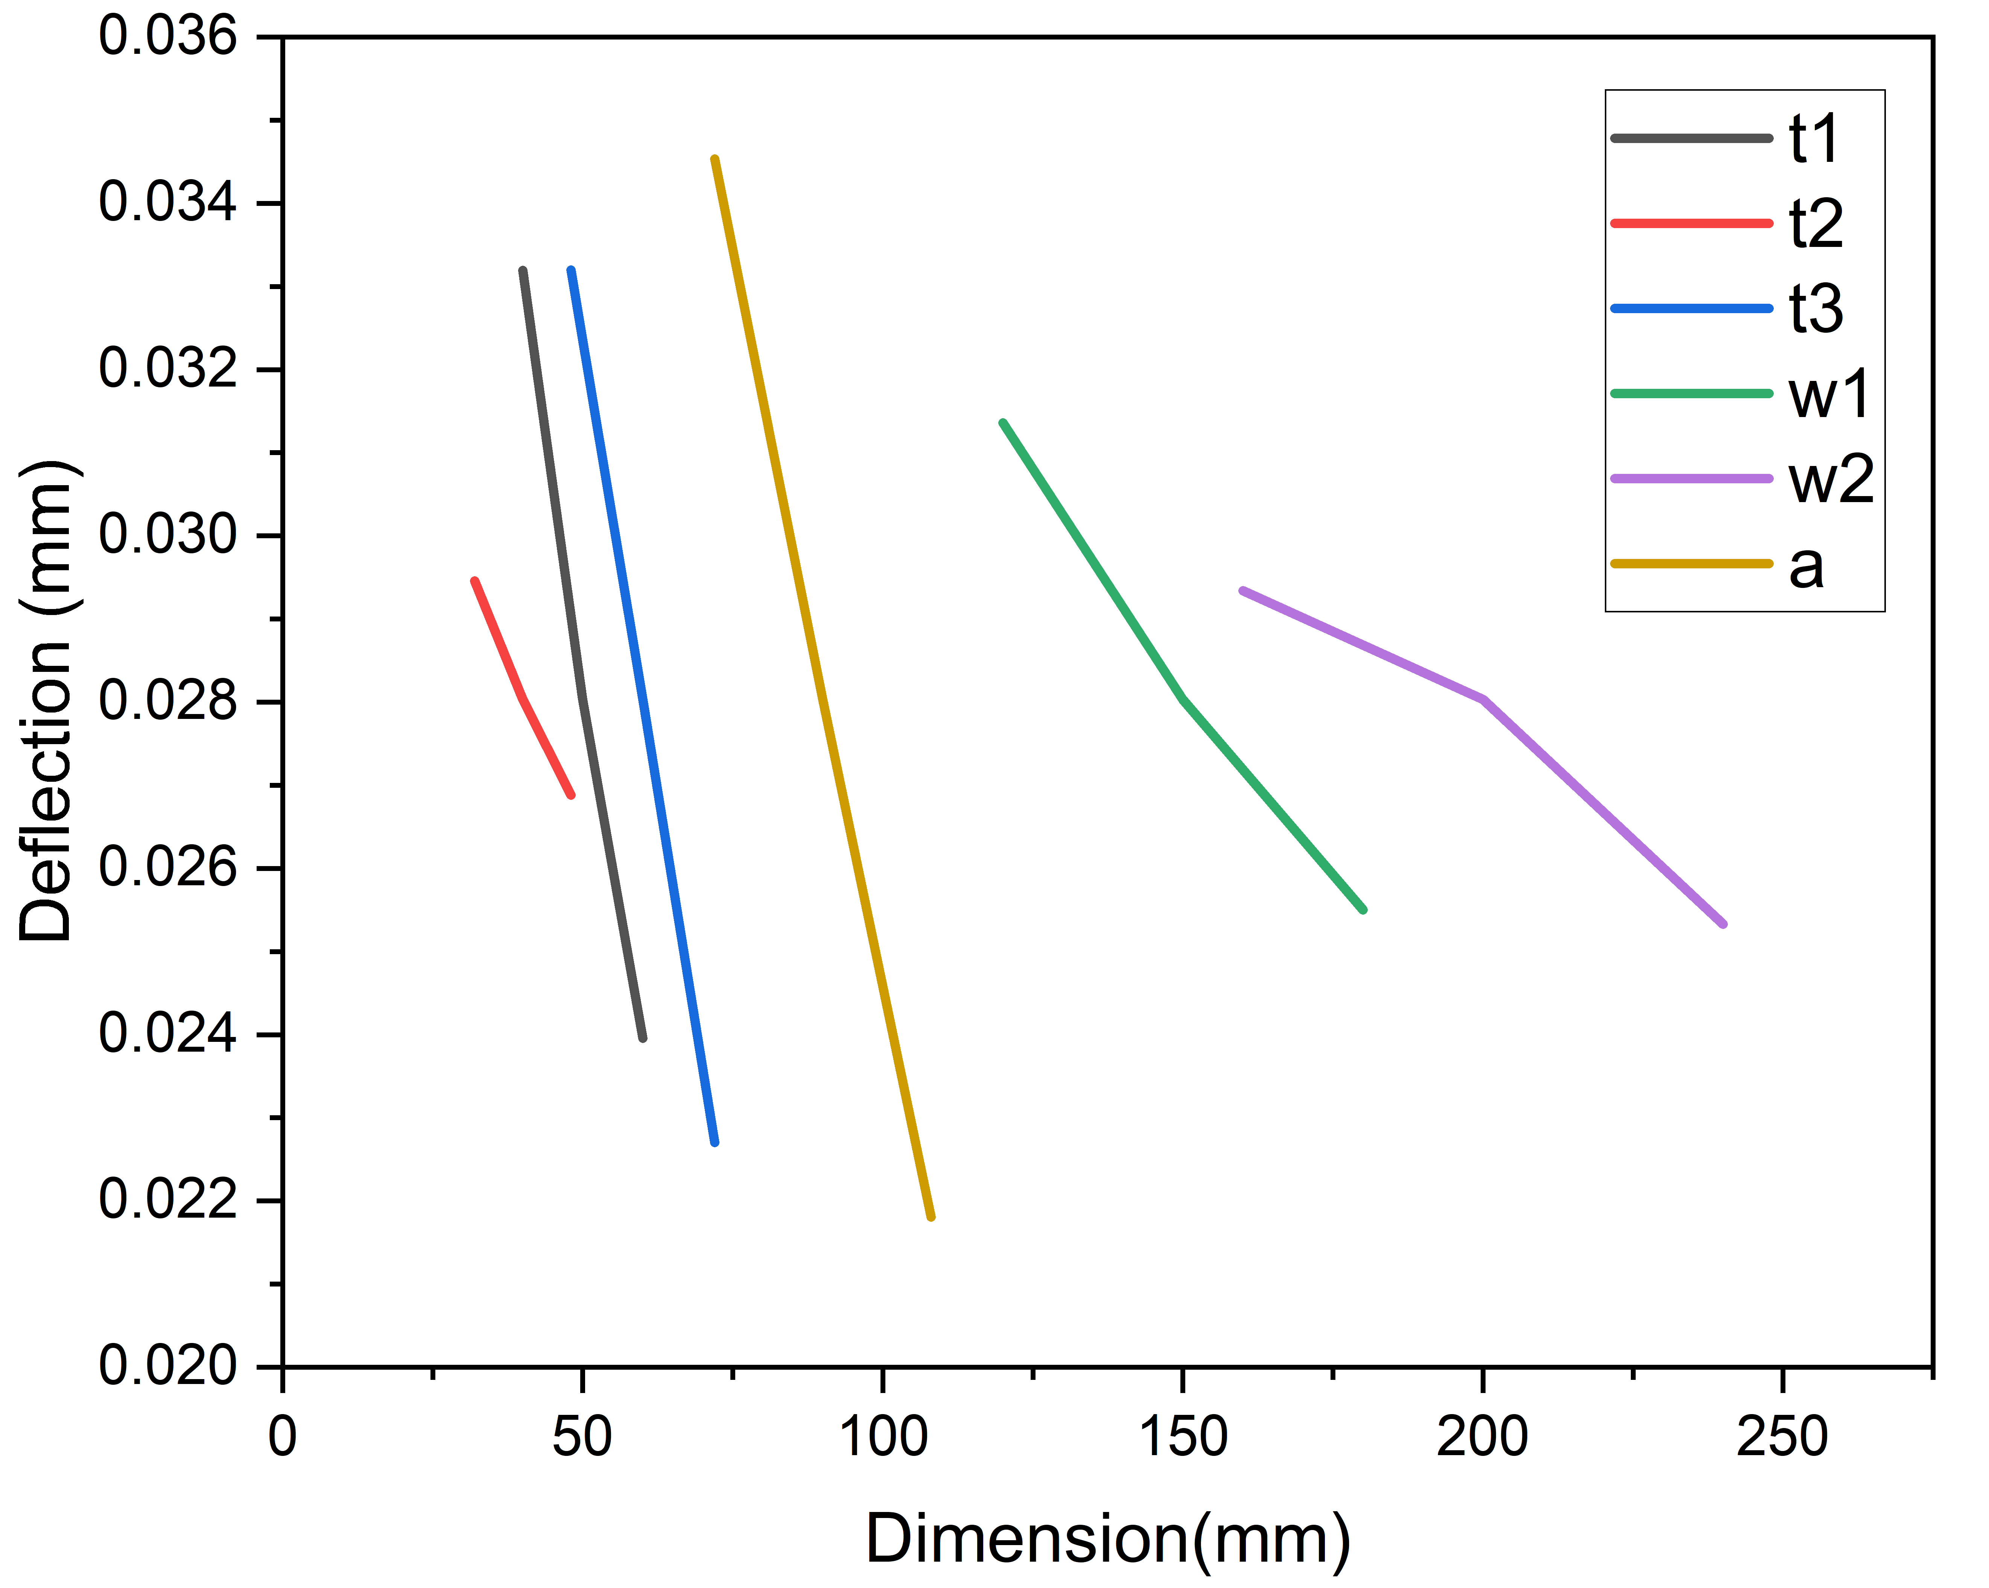
Sensitivity Analysis
The sensitivity of each of the parameters has been analyzed as well.
Fig. Sensitivity analysis

Slide 6
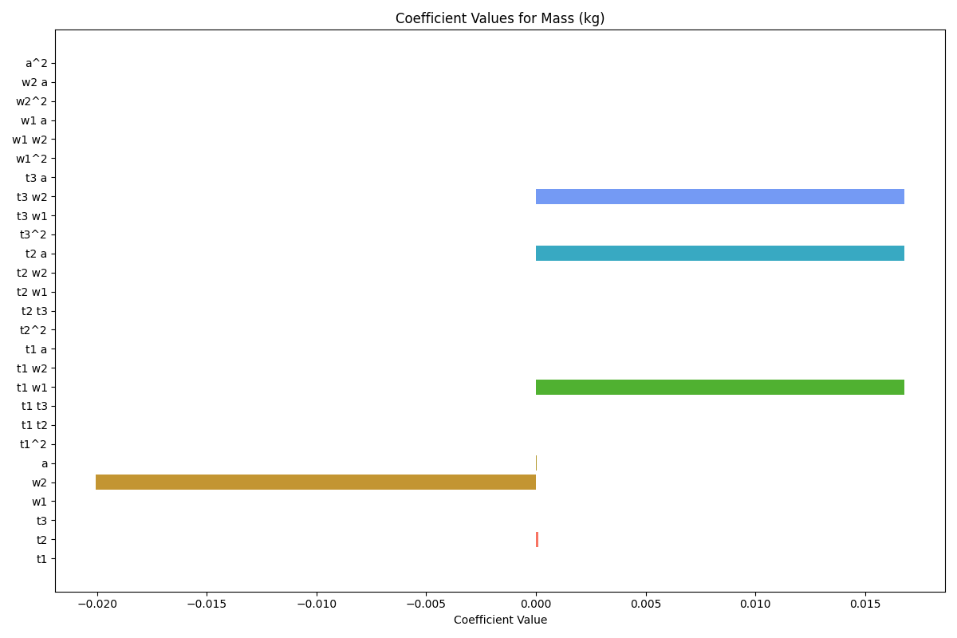
Sensitivity Analysis cont.
The sensitivity of each of the combination parameters has been analyzed as well.

Slide 7
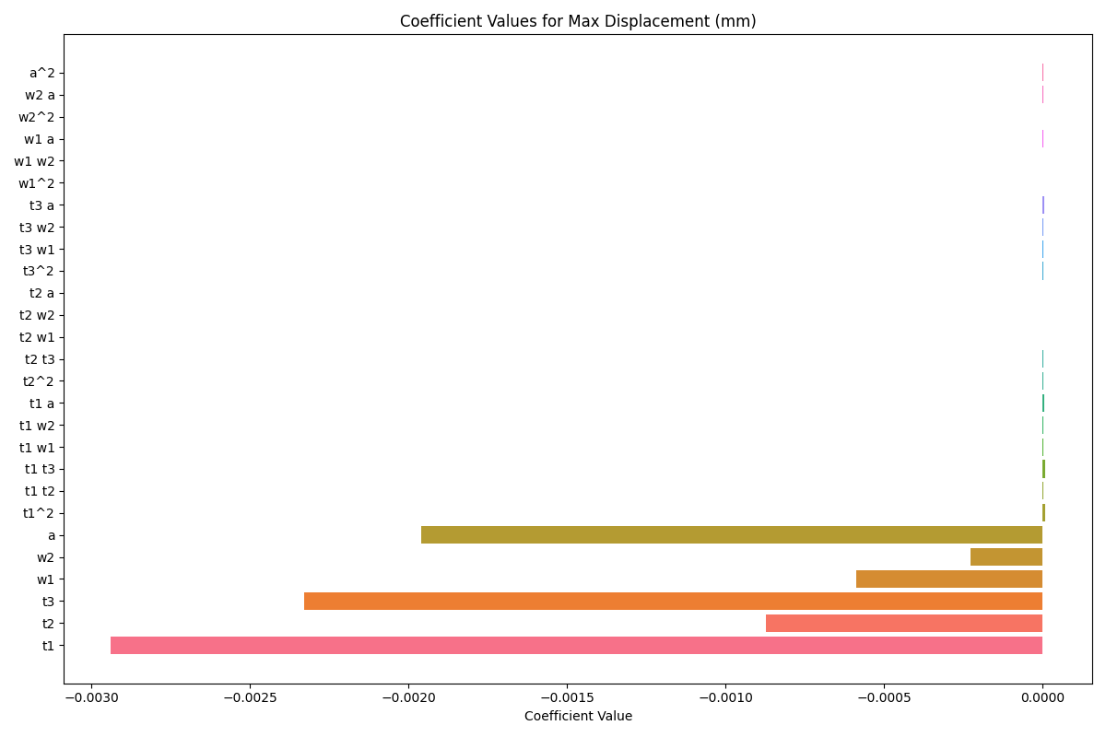
Sensitivity Analysis cont.

Slide 8
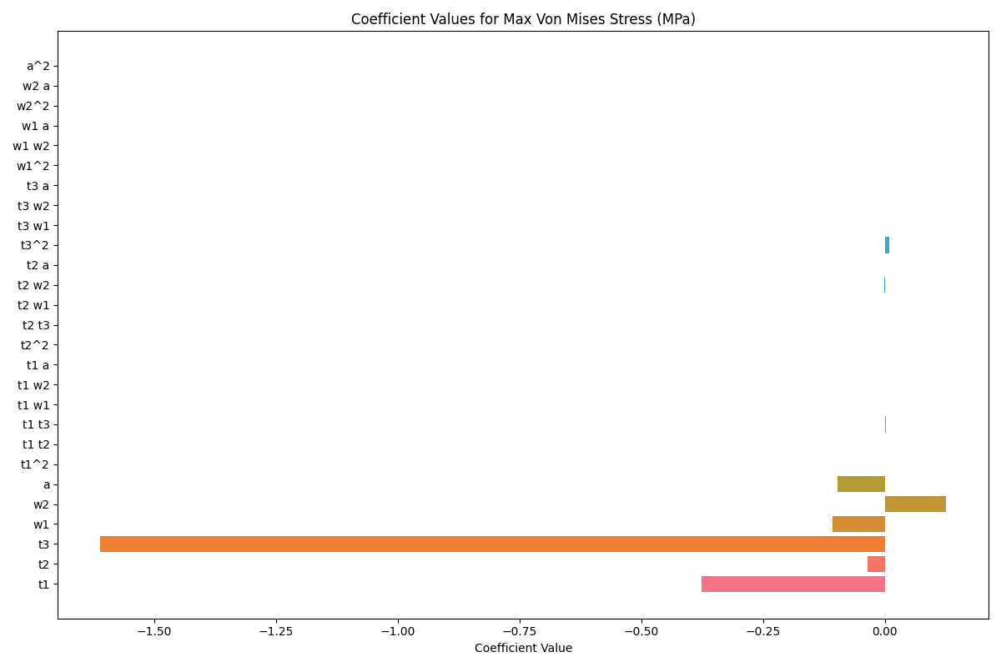
Sensitivity Analysis cont.

Slide 9
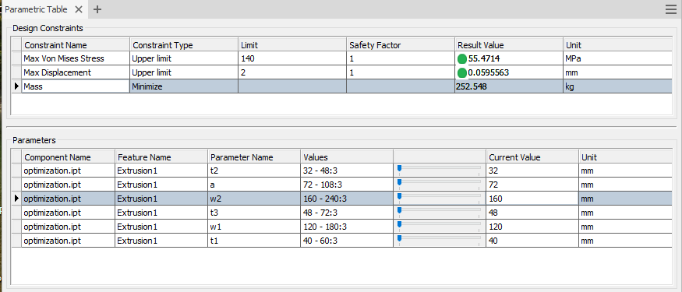
Optimal design as per DOE

Slide 10
Multivariate regression
Expressions
mass_expr = "-0.00600 + 0.00000*1 + 0.00000*t1 + 0.00012*t2 + -0.00000*t3 + -0.00000*w1 + -0.02005*w2 + 0.00006*a + 0.00000*t1**2 + -0.00000*t1*t2 + -0.00000*t1*t3 + 0.01680*t1*w1 + 0.00000*t1*w2 + 0.00000*t1*a + 0.00000*t2**2 + -0.00000*t2*t3 + -0.00000*t2*w1 + 0.00000*t2*w2 + 0.01680*t2*a + 0.00000*t3**2 + 0.00000*t3*w1 + 0.01680*t3*w2 + 0.00000*t3*a + 0.00000*w1**2 + 0.00000*w1*w2 + -0.00000*w1*a + 0.00000*w2**2 + -0.00000*w2*a + -0.00000*a**2"
stress_expr = "73.76782 + 0.00000*1 + -0.37550*t1 + -0.03633*t2 + -1.61078*t3 + -0.10805*w1 + 0.12592*w2 + -0.09745*a + 0.00041*t1**2 + 0.00053*t1*t2 + 0.00208*t1*t3 + 0.00032*t1*w1 + 0.00029*t1*w2 + 0.00037*t1*a + -0.00006*t2**2 + 0.00066*t2*t3 + 0.00009*t2*w1 + -0.00054*t2*w2 + 0.00048*t2*a + 0.00915*t3**2 + 0.00039*t3*w1 + 0.00064*t3*w2 + 0.00022*t3*a + 0.00010*w1**2 + 0.00006*w1*w2 + 0.00014*w1*a + -0.00045*w2**2 + 0.00000*w2*a + -0.00004*a**2"
displacement_expr = "0.40024 + 0.00000*1 + -0.00294*t1 + -0.00087*t2 + -0.00233*t3 + -0.00059*w1 + -0.00023*w2 + -0.00196*a + 0.00001*t1**2 + 0.00000*t1*t2 + 0.00001*t1*t3 + 0.00000*t1*w1 + 0.00000*t1*w2 + 0.00001*t1*a + 0.00000*t2**2 + 0.00000*t2*t3 + 0.00000*t2*w1 + 0.00000*t2*w2 + 0.00000*t2*a + 0.00000*t3**2 + 0.00000*t3*w1 + 0.00000*t3*w2 + 0.00001*t3*a + 0.00000*w1**2 + 0.00000*w1*w2 + 0.00000*w1*a + -0.00000*w2**2 + 0.00000*w2*a + 0.00000*a**2"

Slide 11
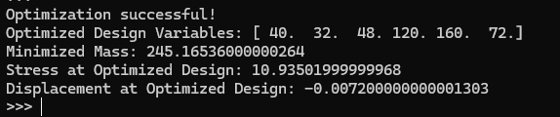
Single objective multi-constraint optimization
The optimization problem is formulated as follows
Minimize, Mass= f(t1,t2,t3,w1,w2,a)
subject to,
Maximum stress <= 140 MPa
Maximum deflection<= 1 mm
40<t1<60
32<t2<48
48<t3<72
120<w1<180
160<w2<240
72<a<108

Slide 12
Comparison
The optimal solution obtained by multivariate regression and optimal design from DOE is not identical.
Both solutions are almost similar.
The error might occurred in fitting the curve in linear regression. The coefficients in the polynomial expression may not be properly capturing the physical behaviour
The values of the parameters are identical in both solutions. Therefore, it can be concluded that both models have suggested the same optimal design.

Slide 13
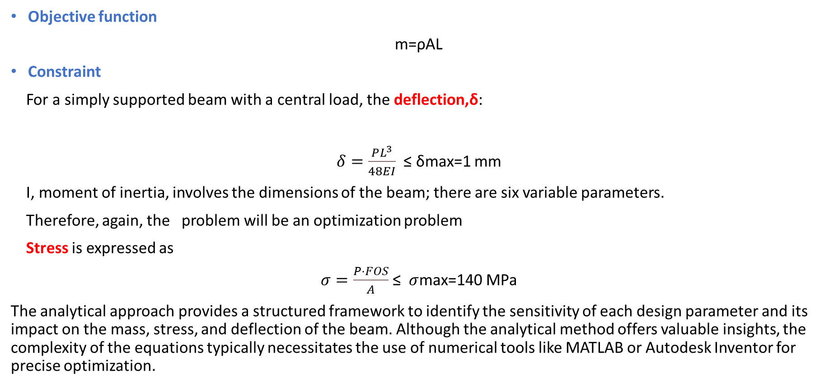
Is an analytical solution possible?
Objective function
m=ρAL
Constraint
For a simply supported beam with a central load, the deflection,δ:
$δ=\frac{PL^{3}}{48EI}$ ≤ δmax​=1 mm
I, moment of inertia, involves the dimensions of the beam; there are six variable parameters.
Therefore, again, the problem will be an optimization problem
Stress is expressed as
$σ=\frac{P⋅FOS}{A}$ ≤ $σ$max=140 MPa
The analytical approach provides a structured framework to identify the sensitivity of each design parameter and its impact on the mass, stress, and deflection of the beam. Although the analytical method offers valuable insights, the complexity of the equations typically necessitates the use of numerical tools like MATLAB or Autodesk Inventor for precise optimization.

Slide 14
The program, data, report and figures can be accessed via this link-
ED Assignment

